Slide 1
INTERCULTURAL COMMUNICATION - I
D. P. CHANDRAMOHAN
Associate Professor
CAS in Linguistics
chandruling@gmail.com

Slide 2
Concept of ICC
Intercultural communication is the verbal and nonverbal interaction between people from different cultural backgrounds. Basically, 'inter-' is a prefix that means 'between' and cultural means… well, from a culture, so intercultural communication is the communication between cultures.
Intercultural communication (or cross-cultural communication) is a discipline that studies communication across different cultures and social groups, or how culture affects communication. ... It also involves understanding the different cultures, languages and customs of people from other countries.

Slide 3
Intercultural communication is also not simply a language proficiency. Yes, communication requires the ability to understand language, but just think about how much of your communication with even your own friends is nonverbal: our body language, our attitudes, the rituals from hand-shaking to the stink eye. Some researchers estimate that up to 93% of all human communication is nonverbal, although according to recent studies, it's actually closer to 60%.
Still, that means that more than half of communication is never spoken. So, intercultural communication is going to take a lot more than just learning a language.
Nature of ICC
Intercultural communication is the verbal and nonverbal interaction between people from different cultural backgrounds. In other words, it's the process of communicating with people from another culture.

Slide 4
Intercultural competence is a range of cognitive, affective, and behavioural skills that lead to effective and appropriate communication with people of other cultures. Effective intercultural communication relates to behaviors that culminate with the accomplishment of the desired goals of the interaction and all parties involved in the situation. Appropriate intercultural communication includes behaviors that suit the expectations of a specific culture, the characteristics of the situation, and the level of the relationship between the parties involved in the situation. It also takes into consideration one's own cultural norms and the best appropriate, comfortable compromise between the different cultural norms.

Slide 5
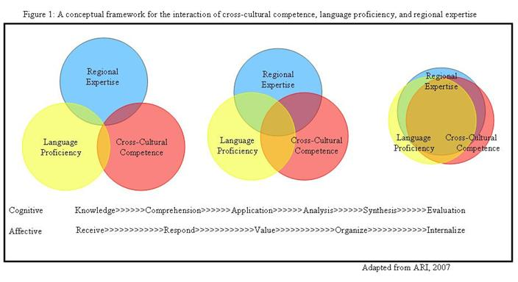

Slide 6
Purpose of ICC
Problem of ICC
Since each culture has its distinct aspects, intercultural communication can be the cause of conflict and disorder. There are three main issues which are at the root of the problem of intercultural miscommunication : language as a barrier, cultural diversity and ethnocentrism.
Importance of ICC
Intercultural Communication Skills. Intercultural communication skills are those required to communicate, or share information, with people from other cultures and social groups. While language skills may be an important part of intercultural communication, they are by no means the only requirement.

Slide 7
Why should we learn ICC
Studying Intercultural Communication is important to help students develop skills and knowledge about cultural awareness and sensitivity to others and to questions of diversity in the workplace.
Elements of intercultural communication
the way in which people of different cultures address each other.
what level of formality or informality makes people comfortable.
non-verbal behaviour, in terms of eye contact, hand gestures, physical proximity and so on.
personal grooming such as dress code and hygiene issues.

Slide 8
There are basically two types of intercultural communication: Verbal communication and non-verbal communication. Verbal communication consists of words used to communicate messages whereas non-verbal communication is gestures that give out messages.
What is culture
Sir Edward Tylor’s definition in 1871 (first use of this term):
“that complex whole which includes knowledge, belief, art, morals, law, custom, and any other capabilities and habits acquired by man as a member of society.

Slide 9
Kroeber and Kluckhohn (1952)
Culture consists of explicit and implicit patterns,
behavior acquired and transmitted by symbols, constituting the individual achievement of human groups, including their embodiment in artifacts,
the essential core of culture consists of traditional (i.e. historically derived and selected) ideas and especially their attached values;
culture systems may, on the one hand, be considered as products of action, on the other as conditioning elements of further action.

Slide 10

John Bodley (1994): Diverse Definitions

Slide 11
Sapir-Whorf Hypothesis
Sapir (1921): “Human beings do not live in the objective world alone, nor alone in the world of social activity as ordinarily understood, but are very much at the mercy of the particular language which has become the medium of expression in that society.”

Slide 12
As a result of differences in language, people in different cultures will think about, perceive, and behave toward the world differently.
Reality itself is already embedded in language and therefore comes preformed. [Reality means anything that exists. ... Something close to reality is realistic. Realityis the state of things as they are, rather than as they may appear or might be imagined. In a wider definition, reality includes everything that is and has been, whether or not we can see it and understand it.]
Language determines, enabling and constraining, what is perceived and attended to in a culture, as well as the upper limits of knowledge.

Slide 13
Creating ICC Competence
Intercultural competence is determined by the presence of cognitive, affective, and behavioral abilities that directly shape communication across cultures. These essential abilities can be separated into five specific skills that are obtained through education and experience:
Mindfulness: the ability of being cognitively aware of how the communication and interaction with others is developed. It is important to focus more in the process of the interaction than its outcome while maintaining in perspective the desired communication goals. For example, it would be better to formulate questions such as "What can I say or do to help this process?" rather than "What do they mean?"
Cognitive flexibility: the ability of creating new categories of information rather than keeping old categories. This skill includes opening to new information, taking more than one perspective, and understanding personal ways of interpreting messages and situations.

Slide 14
Tolerance for ambiguity: the ability to maintain focus in situations that are not clear rather than becoming anxious and to systematically control the best approach as the situation evolves. Generally, low-tolerance individuals look for information that supports their believes while high-tolerance individuals look for information that gives an understanding of the situation and others.
Behavioral (Social / interactive) flexibility: the ability to adapt and accommodate behaviors to a different culture. Although knowing a second language could be important for this skill, it does not necessarily translate into cultural adaptability. The individual must be willing to assimilate the new culture.
Cross-cultural empathy (identification): the ability to visualize with the imagination the situation of another person from an intellectual and emotional point of view. Demonstrating empathy includes the abilities of connecting emotionally with people, showing compassion (sympathy), thinking in more than one perspective, and listening actively.

Slide 15
Culture and language
Culture is a defining feature of a person’s identity, contributing to how they see themselves and the groups with which they identify. Culture may be broadly defined as the sum total of ways of living built up by a group of human beings, which is transmitted from one generation to another. Every community, cultural group or ethnic group has its own values, beliefs and ways of living.
The observable aspects of culture such as food, clothing, celebrations, religion and language are only part of a person’s cultural heritage. The shared values, customs and histories characteristic of culture shape the way a person thinks, behaves and views the world. A shared cultural heritage bonds the members of the group together and creates a sense of belonging through community acceptance.

Slide 16
Language is intrinsic to the expression of culture. As a means of communicating values, beliefs and customs, it has an important social function and fosters feelings of group identity and solidarity. It is the means by which culture and its traditions and shared values may be conveyed and preserved.
Cultural and linguistic diversity is a feature of most nations today as people from different groups live together as a consequence of historical events and human migrations. Within multilingual societies, the maintenance of the languages of the various ethnic and cultural groups is critical for the preservation of cultural heritage and identity. The loss of language means the loss of culture and identity. In many societies throughout history, the suppression of the languages of minority groups has been used as a deliberate policy in order to suppress those minority cultures. As a result a large number of the world’s languages have been lost with the processes of colonisation and migration.

Slide 17
Tamil culture
Tamil culture is the culture of the Tamil people. Tamil culture is rooted in the arts and ways of life of Tamils in India, Sri Lanka, Malaysia, Singapore and across the globe. Tamil culture is expressed in language, literature, music, dance, theatre, folk arts, martial arts, painting, sculpture, architecture, sports, media, comedy, cuisine, costumes, celebrations, philosophy, religions, traditions, rituals, organizations, science, and technology.
Tamils have strong attachment to the Tamil language, which is often venerated in literature as "Tamil̲an̲n̲ai", "the Tamil mother" It has historically been, and to large extent still is, central to the Tamil identity. Like the other languages of South India, it is a Dravidian language, unrelated to the Indo-European languages of northern India. The Tamil language preserves many features of Proto-Dravidian, though modern-day spoken Tamil in Tamil Nadu freely uses loanwords from Sanskrit and English and vice versa.^{[4]} Tamil literature is of considerable antiquity, and is recognised as a classical language by the government of India. Classical Tamil literature, which ranges from lyric poetry to works on poetics and ethical philosophy, is remarkably different from contemporary and later literature in other Indian languages, and represents the oldest body of secular literature in South-east Asia.

Slide 18
Tamils have strong attachment to the Tamil language, which is often respected in literature as "Tamil̲an̲n̲ai", "the Tamil mother". It has historically been, and to large extent still is, central to the Tamil identity. Like the other languages of South India, it is a Dravidian language, unrelated to the Indo-European languages of northern India. The Tamil language preserves many features of Proto-Dravidian, though modern-day spoken Tamil in Tamil Nadu freely uses loanwords from Sanskrit and English and vice versa. Tamil literature is of considerable antiquity, and is recognised as a classical language by the government of India. Classical Tamil literature, which ranges from lyric poetry to works on poetics and ethical philosophy, is remarkably different from contemporary and later literature in other Indian languages, and represents the oldest body of secular literature in South-east Asia

Slide 19
Religion
Ancient Tamil grammatical works Tolkappiyam, the ten anthologies Pattuppāṭṭu, the eight anthologies Eṭṭuttokai sheds light on early religion of ancient Dravidian people. Murugan was glorified as, the god of war, who is ever young and resplendent, as the favored god of the Tamils. Sivan was also seen as the supreme God. Early iconography of Murugan and Sivan and their association with native flora and fauna goes back to Indus Valley Civilization. The Sangam landscape was classified into five categories, thinais, based on the mood, the season and the land. Tolkappiyam, mentions that each of these thinai had an associated deity such Seyyon in Kurinji-the hills, Thirumaal in Mullai-the forests, and Venthan in Marutham-the plains, Kotravai in Palai-the deesert and Wanji-ko/kadalon in the Neithal-the coasts and the seas.

Slide 20
Other gods mentioned were Mayyon and Vaali who were all assimilated into Hinduism over time. Dravidian influence on early Vedic religion is evident, many of these features are already present in the oldest known Indo-Aryan language, the language of the Rigveda (c. 1500 BCE), which also includes over a dozen words borrowed from Dravidian. This represents an early religious and cultural fusion or synthesis between ancient Dravidians and Indo-Aryans, which became more evident over time with sacred iconography, flora and fauna that went on to influence Hinduism, Buddhism and Jainism.

Slide 21
Australia is one of the most culturally and linguistically diverse nations in the world. This diversity has always been embedded in Aboriginal and Torres Strait Islander societies and has been broadened over the last two hundred years with the arrival of people from over one hundred and fifty distinct cultures from around the world.
While English is the dominant language, many people speak a language other than English as their first language within their families and communities. Over two hundred languages other than English are spoken in Australia today. The acquisition of proficiency in Standard Australian English, together with the maintenance of community languages is therefore a significant issue in Australia.

Slide 22
Communication
Definition: Communication is the process of transmitting information from one person to another. It is the act of sharing of ideas, facts, opinions, thoughts, messages or emotions to other people, in and out the organisation, with the use of the channel to create mutual understanding and confidence.
It is not tied to words, i.e. whether an individual speaks or not, the message is automatically conveyed to the other party. Besides words, communication can take place through symbols, letters, actions, expressions, etc.

Slide 23
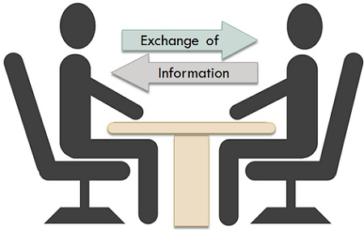

Slide 24
Elements of Communication
Communication is a two way process, wherein interchange of message connects the sender and receiver, towards an agreed direction, consisting seven elements:
Sender: Otherwise known as a source, it is the person who has something to pass on, to another individual.
Encoding: The sender of the message, selects appropriate words or non-verbal techniques to convert the idea into the message, which is called as encoding.
Message: Message implies something that the sender wants to communicate, to the receiver. Without a message, no communication is possible.

Slide 25
Medium: Medium alludes to the channel or mode, through which message is communicated to the receiver, i.e. it can be sent by way of electronic word processing system, graphic, symbol, etc.
Receiver: The one to whom the message is directed, is called receiver. He/she notices and conveys some meaning to the message.
Decoding: The act of interpreting message by the receiver, is termed as decoding. The receiver’s outlook, experience, and attitude play a vital role in decoding message.
Feedback: The process of communication can never be completed, if the response of the receiver is missing. It enables the communicator of a message to know whether the message has been received and interpreted in the same manner as directed.
All the seven elements of communication has a great role to play in the entire process, as there can be some deformation between the intended message and the received one.

Slide 26
Forms of communication
Formal Communication: Alternatively known as official communication, it passes through predefined channels which all the members of the organisation are bound to follow. In every organisation, a corporate ladder is established, through which communication flows, which can be:
  Downward: Superior to subordinate
  Upward: Subordinate to superior
  Horizontal: Between employees of the same level, but different areas of responsibility (department).
  Diagonal: Between employees of different levels and department.

Slide 27
Pattern or ways of grapevine or informal communication
Grapevine is an informal channel of business communication. The management can use grapevine to supplement the formal channels of communication. The patterns, types or kinds of grapevine may divide into different ways. Keith Divide grapevine into four categories-single strand, gossip, probability and cluster chain which are as follow:
  Single strand chain
  Gossip chain
  Probability chain
  Cluster chain
Informal communication is the fastest form of communication, that rapidly transmits information to various members of the organisation. Further, the response of the members can also be obtained quickly.

Slide 28
Single strand or straight chain: Single strand network is an information network where one person will tell a message to another person and he will communicate it to another one person. The third person also will tell the same message to another one person.
Gossip or star chain: Here all the persons in the communication network talk one another informally. In this network someone stays in the center of the system. He is the main or pivotal person.
Probability chain: Probability network is an informational network where each of the individual randomly tells others the same message. The source of information for each of the person hearing the message is different.
Cluster chain: Cluster network is an informational network where someone first tells the message to the selected individuals and those selected individuals pass the same information to other selected individuals and the process continue in the same way. Most of the informal communication follows this chain. Here the pivotal or the center person passes the information to the other persons who pass the information to the other selected persons.

Slide 29
WHAT IS INTERCULTURAL COMMUNICATION
Intercultural communication as a human activity is ancient. Intercultural Communication as an academic discipline is however relatively new.
Intercultural communication (or cross-cultural communication) is a discipline that studies communication across different cultures and social groups, or how culture affects communication. ... It also involves understanding the different cultures, languages and customs of people from other countries.

Slide 30
Historic Overview of Intercultural Communication
For the proper name of the field "Intercultural Communication" credit is often given to American anthropologist Edward T. Hall, who used it for the first time in his book The Silent Language in 1959. The book is sometimes called "the field's founding document" (Hart 1998).
Prior to publishing the book, Hall was a staff member at the Foreign Service Institute, USA (1951-1955), where he, together with his colleagues, worked out what can be called the first original paradigm for Intercultural Communication:

Slide 31
Main elements of Hall's paradigm for Intercultural Communication (Hart 1998) were:
  systematic empirical study and the classification of nonverbal communication (defined as communication that does not involve the exchange of words)
  emphasis, especially in nonverbal communication, on the out-of-conscious level of information-exchange.

Slide 32
focus on intercultural communication, not as earlier on macrolevel monocultural studies
a non-judgmental view toward and acceptance of cultural differences
participatory training methods in Intercultural Communication.
The beginning of Intercultural Communication was for applied purposes rather than for theoretical considerations: Training was the main issue. The first target audience comprised American diplomats and development personnel whose intercultural skills had to be improved.

Slide 33
ICC Skills
Intercultural communication skills are those required to communicate, or share information, with people from other cultures and social groups.
While language skills may be an important part of intercultural communication, they are by no means the only requirement.
Intercultural communication also requires an understanding that different cultures have different customs, standards, social values, and even thought patterns.
Finally, good intercultural communication skills requires a willingness to accept differences these and adapt to them.

Slide 34
Effective intercultural communication is a vital skill for anyone working across countries or continents, including those working for multinational companies either in their home country or abroad (expatriates).
It is also crucial for anyone working with people from other cultures to avoid misunderstandings and even offence. Those studying languages often encounter issues of intercultural communication.
Knowledge for Intercultural Communication
Key areas of knowledge for those wanting to improve their intercultural communication are:
Some knowledge of the cultures, organizations and institutions, history and general way of living of different communities and nations.
Recognition that these aspects affect behavioural norms. For example, there is considerable ‘history’ between the Greeks and Turks, and therefore it may be considered potentially a problem to serve Turkish food to a Greek person.

Slide 35
An understanding of how culture can affect communication and language. For example, people from Nordic countries are often said to speak more directly than native English speakers who tend to use more ‘polite’ language. Scandinavians in the UK have reported causing offence to English people by failing to say ‘please’ and ‘thank you’ enough.
Some understanding of the conventions that may govern behaviour in certain specific intercultural environments, such as views on the role of women, or the licence (or otherwise) permitted to children.
Crucially, awareness of your own and other people’s beliefs and values, and a willingness to recognize when these may clash.
Sensitivity towards cultural stereotypes that may affect and interfere with intercultural communication

Slide 36
10 Tips for Improving Your Intercultural Communication Skills
This is Part 2 of a three part series on intercultural communications. Part 1 addressed the complexity of culture and how it can impact communications when individuals from one culture interact with individuals from another. In this feature, we focus on the lessons we've learned from our cross cultural interaction and how you can use those tips to achieve impactful, successful cross-cultural communications.
How can you improve intercultural communications?
There are a number of strategies that can be used to better understand and improve intercultural communications. And, while it depends on the situation and what component of culture you are dealing with, the guidelines listed below can be used to help in any cross-cultural situation to make sure your message and intention is clear, and that you understand what others are saying.

Slide 37
Tips for Achieving Successful Intercultural Communications:
1. Do your homework.
If you know ahead of time who you will be speaking with or what country you will be visiting, it makes sense to research cultural norms and standards, and communication methods for that particular place. Do not walk into the situation unprepared if you can avoid it.
2. Ask.
It might be uncomfortable for you and the person you are asking, but by showing your willingness to ask when you don't understand or when you lack the cultural knowledge necessary to avoid cultural fake, you are demonstrating your willingness to learn more about a new culture and the dominant communication norms instead of rushing through unaware.

Slide 38
3. Accept that you'll commit errors.
Even with all the research you're going to do and the questions you're going to ask, you will still make mistakes. Don't take it personally, rather do your best to be self-aware, actively learn from your mistake and apologize if you offend anyone or cross boundaries. Mistakes will always happen, the problem begins when you don't use a mistake as an opportunity to learn to avoid the same issues in the future.
4. Avoid colloquialisms, jokes and idioms.
Humor is culture oriented and until you have spent significant months or years learning it, jokes should be avoided as it can be easy to offend or belittle, and in professional situations that can spell disaster. Idioms should be avoided for a different reason, and that is that they vary greatly by culture and often aren't translatable. In Colombia, "Hacemos la vaca" means to collect money to buy something together. It has no literal meaning and if you weren't with someone who could explain, you would be very confused as to why people were making a cow.

Slide 39
5. Practice actively listening and observing.
Listening is a highly regarded skill. When communicating with others from another culture, it is incredibly important to actively pay attention and listen to what people are telling you. Listening can help you understand that there isn't one right way to conduct interactions. Additionally, varying viewpoints or ideas might contradict your own, but you'll still need to listen respectfully.
6. Repeat or confirm what you think was being said.
It can be helpful to repeat or confirm what you believe to have been the objective of the conversation. This process will help you avoid misunderstandings, especially when speaking different languages. Write it out if you have to, but make sure you align everyone's understanding before moving forward.

Slide 40
7. Don't ask yes or no questions.
Instead, use open ended questions to avoid confusion. With open ended questions, the person with whom you are interacting must explain or clearly outline their point, making it easier to understand their response and the context surrounding it.
8. Pay attention to nonverbal communication.
Communication is also extremely nonverbal. Pay attention to nonverbal cues such as intonation, eye contact, and posture. Observe how people conduct interactions with others from their same culture and follow their lead. Certain cultures avoid strong eye contact when speaking, so you'll make someone highly uncomfortable if you are trying to force strong eye contact they are not used to doing the same.

Slide 41
9. Speak slowly and clearly.
This will help you avoid mistakes and seeming nervous. Speaking slowly and clearly is often interpreted as being confident. Additionally, taking time to think before you speak can help you to avoid communication issues and words you might regret later.
10. Take a deep breath and enjoy it!
It can be a challenge to communicate effectively with people from other cultures, and you are bound to find people with whom you can communicate more effectively and more enjoyably than others. Remember, that the whole process is a lifelong lesson in empathy, understanding, and self-awareness which can translate to vastly improved professional and personal interactions and successes beyond just intercultural communications. So, take a deep breath and start communicating!

Slide 42
High Context & Low Context Culture
Edward T. Hall (1914--) American anthropologist The forefather of Intercultural Communication.
The Definition of Context: Context is the information that surrounds an event; it is inseparably bound up with the meaning of that event.
Context: Background Information - Ethnic or cultural background is not the same as nationality or place of birth. Your ethnic or cultural background means the group from which you descend and that shares a distinct identity.

Slide 43
We can compare culture by how much people’s communication trusts on background information.
Think of the standard Indian head wobble. For the outsider, this can be extremely confusing. Is that person saying yes? no? maybe? don't know? It can mean all these things: the context of the action will make its meaning clear to a person familiar with the culture - not so for an outsider.

Slide 44
High-context cultures are those that communicate in ways that are implicit and depend on heavily on context. In contrast, low-context cultures rely on explicit verbal communication. High-context cultures are communalist value interpersonal relationships, and have members that form stable, close relationships.
Low context implies that a lot of information is exchanged explicitly through the message itself and rarely is anything implicit or hidden. People in low context cultures such as the UK tend to have short-term relationships, follow rules and standards closely and are generally very task-oriented. United States and Australia, are generally considered to be low-context cultures.
High context: A high context culture is one in which the communicators assume a great deal of team spirit of knowledge and views, so that less is spelled out explicitly and much more is implicit or communicated in indirect ways. What is encoded matters less than the context.

Slide 45
Low context Low context: Pay little attention to messages sent non-verbally. Communication is the exchange of verbal messages that are meaningful apart from the context in which they are said. Respond to what people say rather than to how they are behaving.
High context: Expect listeners to take more responsibility for interpreting the meaning of messages. Assume that speakers do not always express their meaning fully or precisely in words. Body language, facial gestures and voice inflection are important methods of communication.
Low context: More impersonal and precise relationships between individuals are relatively shorter in duration. Deep personal involvement with others is valued less.

Slide 46
Low context: Business can be conducted successfully by letters, telephones, fax or e-mail. Tend to have strong legal frameworks for commercial transactions and rarely rely on personal interaction.
High context: The physical backgrounds for a meeting or a business meal are just as important as the substance of the discussion. Agreements tend to be spoken rather than written.
  [Business meals (essentially meetings with food) can take many forms, from casual to more formal. What they all have in common is a measure of sociability over and above that of an office-bound appointment.]

Slide 47
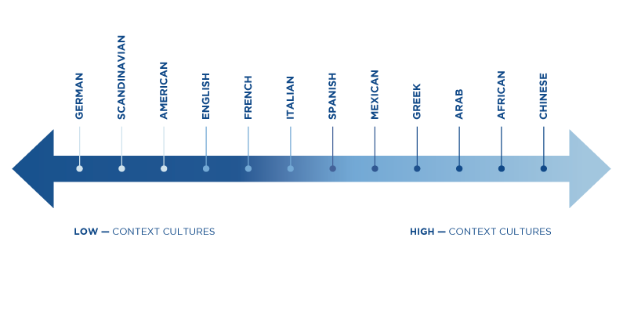

Slide 48
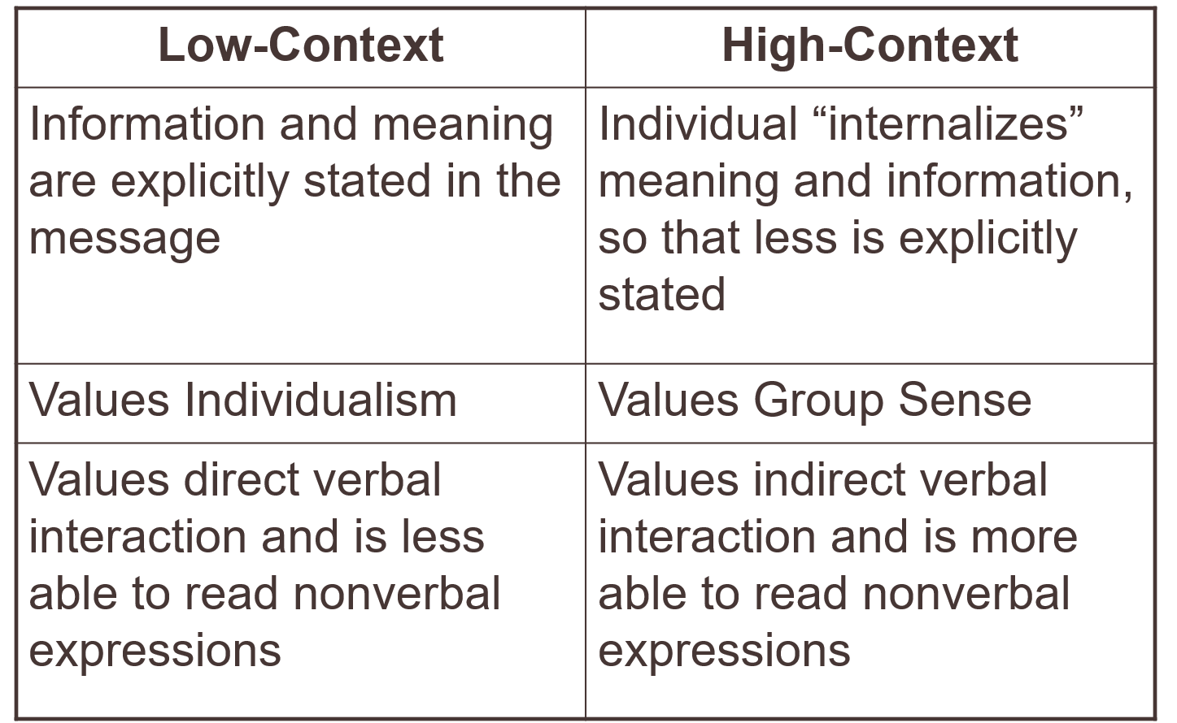

Slide 49
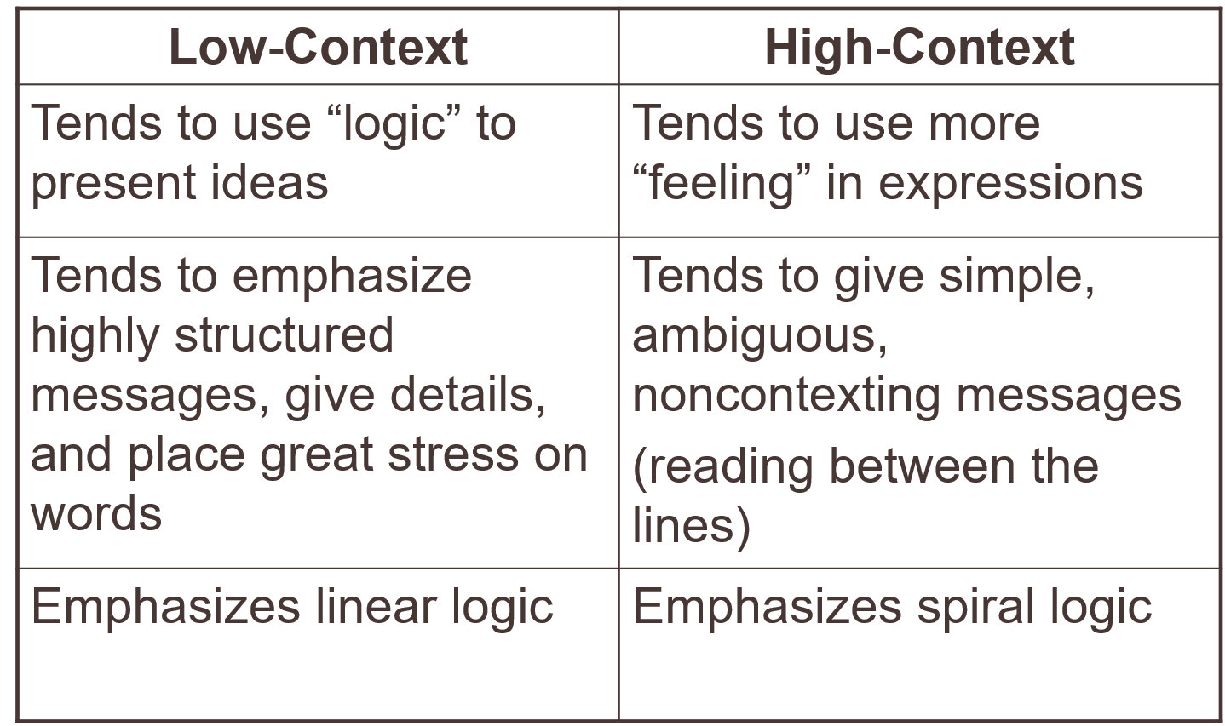

Slide 50
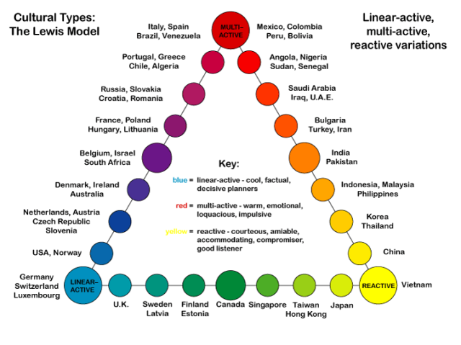

Slide 51
Why has India evolved a high-context culture?
Indian society, particularly Hindu society (but also with other religious groups, just less so), has a well- engrained caste system. It dictates whole paths of life, and Indians are brought up with a huge amount of implicit knowledge of different castes. The consequence is that India is extremely high context.
Indian languages reflect this and linguistics can also be seen as a reason for India's high-context culture. In English, we use the pronoun 'you' to refer to anyone. In Hindi, three equivalent pronouns exist - aap, tum and tu - that are used in different contexts depending on whom you're speaking to. Hindi speakers know which form to use instinctively. Outsiders risk offending someone if they get it wrong.

Slide 52
English had this too. English historically made use of 'thou' in addition to 'you'. 'Thou' sounds formal now, but historically this was an informal (sometimes rude) pronoun; 'you' was highly formal. We lost this subtlety long ago. (Some northern English dialects retain it.) Speakers of English tend to be direct (low context) and will spell out directions explicitly: Indians do not (generally). French continues to make use of tu (informal singular) and vous (formal and/or plural): French culture is usually seen as being of a higher context than British or American culture.

Slide 53
Indians can seem rather rude and direct when speaking in English, which can lead to the illusion of a low-context culture.
This can often be attributed to translation from Hindi and other languages. While Hindi does have a word for please (krpaya) it is very rarely used.
Instead, verb endings connote different levels of politeness. Take the verb 'to go'. In Hindi, this is jaanaa in the infinitive form.
To give the command 'please go', you'd say jaaie. This is polite. You could say instead jaao. In this form, it's direct, urgent and rude (context depending) - 'GO!' Indians can sometimes struggle to translate this into English.

Slide 54
Language and Identity
The importance of identity Who am I?
Multiple identities:
I am…
I am…
I am…
I am…
I am…

Slide 55
Definition of Identity
“the reflective self-conception or self-image that we each derive from our fasocializationmily, gender, cultural, ethnic, and individual process”.
Indi­vidu­als are sur­roun­ded by large social forces; they live their lives with lim­ited options avail­able to them when mak­ing decisions and choices.

Slide 56
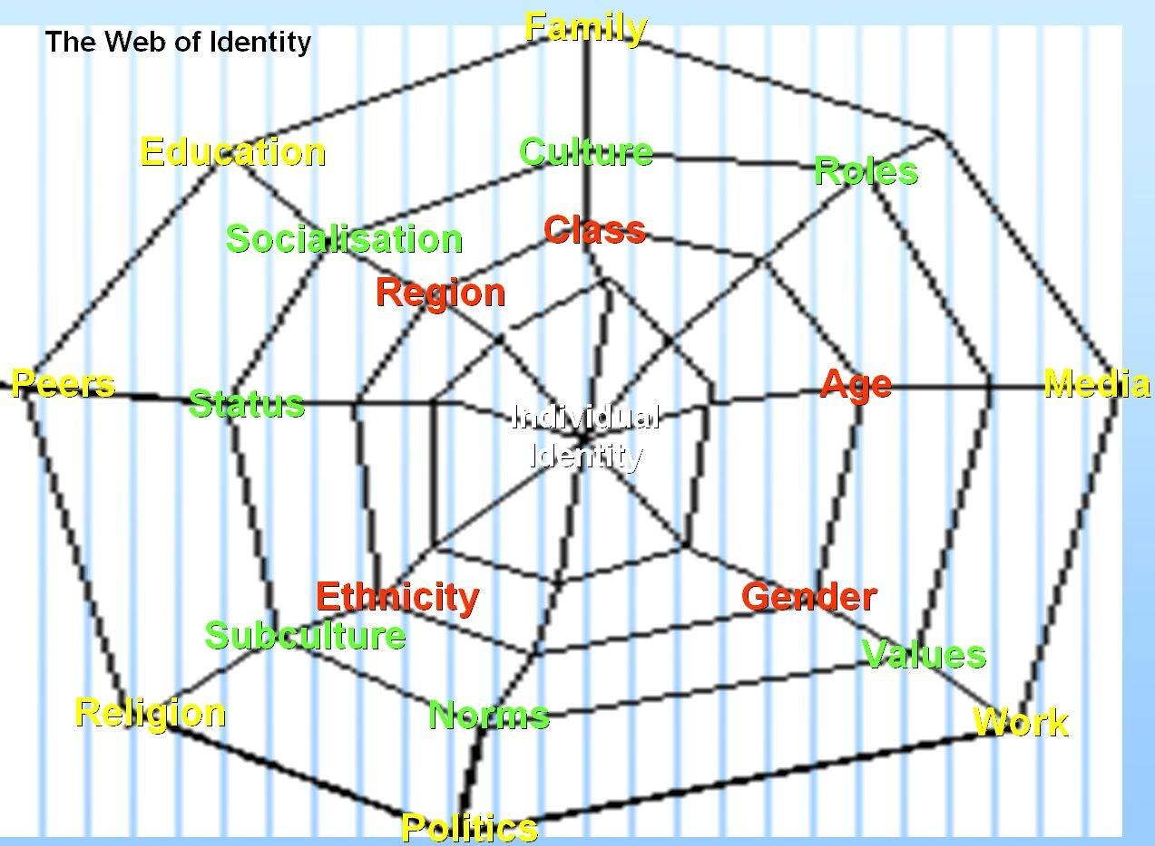

Slide 57
Majority Identity Development
Rita Hardiman (1994, 2003), educator and pioneer in antiracism training, presents a model of majority identity development that has similarities to the model for minority group members. Although she intended the model to represent how white people develop a sense of healthy racial identity, it can also be helpful in describing how other majority identities develop—straight sexual orientation, Christian religious identity, male gender identity, middle-class identity, and so on. Again, remember that majority identity, like minority identity, develops through a complex process. And this model—unlike some other identity development models—is prescriptive. In other words, it outlines the way some scholars think a majority identity should develop, from accepting societal hierarchies that favor some identities and diminish others to resisting these inequities.

Slide 58
Family Identity
The “Family Identity” is based on ‘Civil Identity’ closely associated with a specific surname.
Surname: That specific family name passed down line generation after generation in a family lineage, from whom the origins of the surname-to the very youngest new born.
Middle name: ‘NMI’ (means No Middle Initial). It is a name traditionally given by joint parents, by inter-marrying families of the same ‘civil identities’ to protect the family against fraud, phonys and fakes using reputable ‘names’ as a tactic or strategy to profit in multicultural finance.

Slide 59
First name: A personal name given to a newborn by parents – culturally, to be used in every day conversations-with a specific meaning – concerning the reputation to ‘live up to’ in society.
Three levels of identity (Hall)
Personal (what makes us unique)
Relational (our relationships with others)
Cultural, Communal or Social (large-scale communities such as nationality, ethnicity, gender, religious or political affiliation)

Slide 60
Write Your Identity
Now work in USA talking about yourself. Use these questions to help you.
What’s your name?
Where were you born? When?
What’s your address? (Where do you live?)
What’s your school? (Where do you go?)
What class are you in
What are your hobbies?
What are your parent’s names?
What is your blood type?
What is your email id?

Slide 61
What makes up your personal identity
Groups or clubs that you belong to – scouts, rugby, choir etc
What your interests or talents are – film, dance, speed stacking etc
What things are important to you
what your hopes are for the future
Which people are important to you
your religion
The languages that you speak…

Slide 62
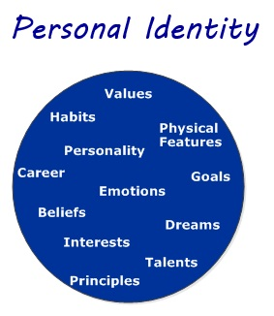
Personal Identity

Slide 63
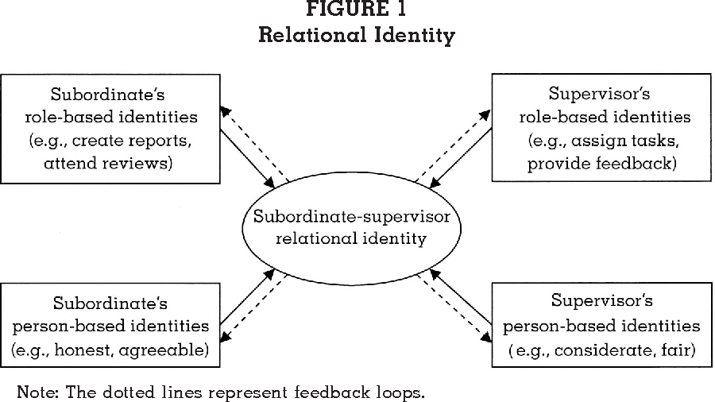

Slide 64
Identity in Intercultural Interactions
“Cultural identity is a focal element in intercultural communication”
In intercultural communication, participants will have to search for a middle ground between their different communication styles.
With so many intercultural marriages, for instance many US youths consider cultural diversity as a normal part of social life. “There is a growing willingness—and ability—to cross cultures, where one’s personal identity is shaped more by cultural preferences than by skin color”.

Slide 65
Identity and Cultural Identity
Identity: A reflective self-conception or self-image that we each derive from our family, gender, cultural, ethnic and individual socialization process.
Cultural Identity: Shared system of symbolic verbal and non-verbal behaviour meaningful to a group. It is the identity of a group or culture, or of an individual as her/his belonging to a group or culture affects her/his view of her/him. People who feel they belong to the same culture share a common set of norms.

Slide 66
Selected Social Identities
Racial Identity / Ethnic Identity
Gender Identity / National Identity
Regional Identity / Organizational Identity
Personal Identity / Cyber / Fantasy Identity
Others include age, religion, physical ability, socio-economic class.

Slide 67
Racial Identity
Race is a social construct arising from efforts to categorize people into different groups.
Science has determined there is very little genetic variation among humans.
Human population wil become more alike as the races merge.

Slide 68
Ethnic Identity
Ethnicity is derived from a sense of shared heritage, history, traditions, values, similar behaviours, area of origin, language.
Ethnicity of many Americans/ Canadians is tied to ancestors’ place of orgin prior to coming to North America.

Slide 69
Gender Identity
Gender refers to how a particular culture differentiated masculine and feminine social roles.
Culture influences on what constitutes gender beauty and how it is displayed. Ex. Fashion in Denmark, Language in Japan, Tanning in Europe / America.

Slide 70
What to Wear in Denmark
Colors. Shirt | Tee | Blouse. It's easy to blend in with the native Danes if you know which colors to pack for your trip. ...
Bottoms. Jeans | Pants | Tights. It should come as no surprise that black skinny jeans are the bottoms of choice. ...
Biking. Bag | Backpack. ...
Makeup. Eyeliner | Eye Shadow.

Slide 71
National identity
National identity is a person's identity or sense of belonging to one state or to one nation. It is the sense of a nation as a cohesive whole, as represented by distinctive traditions, culture, language and politics.

Slide 72
Regional Identity
Smaller divisions of geographic area. Cultural contrast among these regions may be manifested through ethnicity, language, accent, dialect, customs, food, dress, historical and political legacies.

Slide 73
Organizational Identity
In collectivistic cultures organizational affiliation is often more important.
Ex. In Japan where people are often introduced firstly by where they work.

Slide 74
What is verbal intercultural communication?
Verbal strategies in intercultural communication enhance the ability to produce or understand speech between members of different cultures.
“Verbal Communication.”
We may often think that, having good communication skills is all about the ability to speak well….. Or all about “SPEAKING.”

Slide 75
Verbal communication is the use of sounds and words to express yourself, especially in contrast to using gestures or mannerisms.
An example of verbal communication is saying “No” when someone asks you to do something you don't want to do.
Perhaps
Yes

Slide 76
Verbal Communication has another very important part…… “LISTENING”.
“Speaking” + “Listening” = “Verbal Communication.”
Listening involves identifying the sounds of speech and processing them into words and sentences. Listening in any language requires focus and attention. It is a skill that some people need to work at harder than others.

Slide 77
It involves five stages:
Receiving
Understanding
Evaluating
Remembering
Responding

Slide 78
Broadly, LISTENING may be classified into TWO
Sympathetic Listening
and
Empathetic Listening.
Sympathetic LISTENING…
In sympathetic listening we care about the other person and show this concern in the way we pay close attention and express our sorrow for their ills and happiness at their joys.
In other words there is “sharing” of feelings.

Slide 79
Empathetic LISTENING…
When we listen empathetically, we go beyond sympathy to seek a truer understanding of how others are feeling. This requires excellent discrimination and close attention to emotional signals. When we are being truly empathetic, we actually acknowledge what they are feeling.
In order to get others to expose these deep parts of themselves to us, we also need to demonstrate our empathy in our behavior towards them, listening sensitively and in a way that encourages self-disclosure.

Slide 80
Speaking consists of two parts…
1) “What to Speak.”
and
2) “How to Speak.”
“What to Speak.”
Content development:
*The first step is Brainstorming.
*The next step is to choose a Presentation Format/ Storage System.
*The Final step is the Presentation itself.

Slide 81
Brain Storming…
Individual Brainstorming is the process of you getting your ideas out on paper.
The idea is to put down all of / most of your ideas on paper. This has two advantages.
It encourages the unrestricted flow of thoughts.
It facilitates the strategic or comparative evaluation of your ideas. i.e. Once on paper, you have the opportunity of ranking your ideas in terms of importance and efficacy. You may now put your ideas against one another and choose the best ones.

Slide 82
Putting them all together…
Now that we know what we are going to speak, we need to put down all our ideas in the most presentable manner.
We need a Format as per which we may present these Ideas. We may call it a Presentation/Display Format or a Storage System.

Slide 83
Storage System 1
IBC… format…
1.Introduce the Topic or what you are going to say.
2.In the Body, add a few Supporting ideas to build further.
3.End with appropriate Conclusion.

Slide 84
Storage System 2
1.What… Begin with the End/Conclusion….
2.How….How do we support the Conclusion..
3.Prove It…. Using examples/Case Studies/Statistics.
4.Conclude with… I hope I have been able to…..(use conclusion used in the beginning).

Slide 85
Storage System 3
Time Sequence…
1.Start with Reference/Relevance to The Past…
2.Continue with Reference/Relevance to The Present…
3.Project The Future (With Personal Touch).

Slide 86
2) “How to Speak.”
Speed
Clarity
Punctuation
Pronunciation
Familiarity
Fluency
Expression

Slide 87
Nonverbal communication
Nonverbal communication is the process of sending and receiving messages without using words, either spoken or written. Also called manual language. Similar to the way that italicizing emphasizes written language, a nonverbal behavior may emphasize parts of a verbal message.
According to experts, a substantial portion of our communication is nonverbal. Every day, we respond to thousands on nonverbal cues and behaviors including postures, facial expression, eye gaze, gestures, and tone of voice. From our handshakes to our hairstyles, nonverbal details reveal who we are and impact how we relate to other people.

Slide 88
Body language refers to the nonverbal signals that we use to communicate. According to experts, these nonverbal signals make up a huge part of daily communication. From our facial expressions to our body movements, the things we don't say can still convey volumes of information.
It has been suggested that body language may account for between 50 percent to 70 percent of all communication. Understanding body language is important, but it is also essential to pay attention to other cues such as context. In many cases, you should look at signals as a group rather than focusing on a single action.
Here's what to look for when you're trying to interpret body language.

Slide 89
Facial Expressions
Facial expressions are responsible for a huge proportion of nonverbal communication. Consider how much information can be conveyed with a smile or a frown. The look on a person's face is often the first thing we see, even before we hear what they have to say.
Just a few examples of emotions that can be expressed via facial expressions include:
Happiness
Sadness
Anger
Surprise
Disgust
Fear
Confusion
Excitement
Desire
Contempt

Slide 90
Gestures
Deliberate movements and signals are an important way to communicate meaning without words. Common gestures include waving, pointing, and using fingers to indicate numeric amounts. Other gestures are arbitrary and related to culture.
In courtroom settings, lawyers have been known to utilize different nonverbal signals to attempt to power judge opinions. An attorney might glance at his watch to suggest that the opposing lawyer's argument is tedious or might even roll his eyes at the testimony offered by a witness in an attempt to undermine his or her credibility. These nonverbal signals are seen as being so powerful and influential that some judges even place limits on what type of nonverbal behaviors are allowed in the courtroom.

Slide 91
Paralinguistics
Paralinguistics refers to vocal communication that is separate from actual language. This includes factors such as tone of voice, loudness, inflection, and pitch. Consider the powerful effect that tone of voice can have on the meaning of a sentence. When said in a strong tone of voice, listeners might interpret approval and enthusiasm. The same words said in a hesitant tone of voice might convey disapproval and a lack of interest.

Slide 92
Consider all the different ways that simply changing your tone of voice might change the meaning of a sentence. A friend might ask you how you are doing, and you might respond with the standard "I'm fine," but how you actually say those words might reveal a tremendous amount of how you are really feeling. A cold tone of voice might suggest that you are actually not fine, but you don't wish to discuss it. A bright, happy tone of voice will reveal that you are actually doing quite well. A somber, downcast tone would indicate that you are the opposite of fine and that perhaps your friend should inquire further.

Slide 93
Body Language and Posture
Posture and movement can also convey a great deal of information. Research on body language has grown significantly since the 1970's, but popular media have focused on the over-interpretation of defensive postures, arm-crossing, and leg-crossing, especially after publishing Julius Fast's book Body Language.

Slide 94
Proxemics
People often refer to their need for "personal space," which is also an important type of nonverbal communication. The amount of distance we need and the amount of space we perceive as belonging to us is influenced by a number of factors including social norms, cultural expectations, situational factors, personality characteristics, and level of familiarity. For example, the amount of personal space needed when having a casual conversation with another person usually varies between 18 inches to four feet. On the other hand, the personal distance needed when speaking to a crowd of people is around 10 to 12 feet.

Slide 95
Eye Gaze
The eyes play an important role in nonverbal communication and such things as looking, staring and blinking are important nonverbal behaviors. When people encounter people or things that they like, the rate of blinking increases and pupils dilate. Looking at another person can indicate a range of emotions including hostility, interest, and attraction.
People also utilize eye gaze as a means to determine if someone is being honest. Normal, steady eye contact is often taken as a sign that a person is telling the truth and is trustworthy. Shifty eyes and an inability to maintain eye contact, on the other hand, is frequently seen as an indicator that someone is lying or being deceptive.

Slide 96
Haptics
Communicating through touch is another important nonverbal behavior. There has been a substantial amount of research on the importance of touch in infancy and early childhood. Touch can be used to communicate affection, familiarity, sympathy, and other emotions.
Women tend to use touch to convey care, concern, and nurturance. Men, on the other hand, are more likely to use touch to assert power or control over others.

Slide 97
Appearance
Our choice of color, clothing, hairstyles, and other factors affecting appearance are also considered a means of nonverbal communication. Research on color psychology has demonstrated that different colors can evoke different moods. Appearance can also alter physiological reactions, judgments, and interpretations. Just think of all the subtle judgments you quickly make about someone based on his or her appearance. These first impressions are important, which is why experts suggest that job seekers dress appropriately for interviews with potential employers.

Slide 98
Nation and Culture & Intercultural Competence
“Cultural influences” on communication are group-held values, norms, beliefs and attitudes that influence the interaction. Triandis calls these the subjective culture, as opposed to the physical and even behavioral expressions of culture (objective culture).
The influential cross-cultural psychologist Harry Triandis noted that culture can be divided into material or objective culture and subjective culture.
Material culture refers to products made by man, such as dress and tools.
Subjective culture, is the intangible part of culture, which could include ideas, attitudes, assumptions, and beliefs.

Slide 99
Attitudes are ideas complicated by a mix of cognitive, emotional, and behavioral factors and they differ considerably across cultures. Norms and roles are behavioral guidelines. The sequence of behaviors (i.e., tasks) can also vary across cultures. Values as well as value orientations(a broader set) represent what is generally desirable in a culture.
We can study subjective culture using two lenses. “Etic” refers to the general categories that can be found in all cultures((An etic view of a culture is the perspective of an outsider looking in; Customs, laws, dress, architectural style, social standards, religious beliefs, and traditions are all examples of cultural elements,), which serve as common grounds for comparison.

Slide 100
“Emic” means categories that might only make sense in a given culture, which makes cultures unique and meaningful to those who belong to it. (An emic view of culture is ultimately a view focus on the inherent cultural distinctions that are meaningful to the members of a given society, often considered to be an ‘insider’s’ perspective).
subjective culture contains elements that reflect cultural differences , either as etic or emic items. Cross-cultural studies require extra effort to validate constructs and remove alternative explanations.

Slide 101
Cultural versus Individual difference:
It seems like self- understanding based on individualism and collectivism which are not same thing.
It describes a cultural orientation
A cultural orientation is an feeling to think, feel or act in a way that is culturally determined. It defines the basis of differences among cultures such self-identity, interpersonal relationships, communication, resolving conflict.
Thus, even though one might live in an individualistic culture, he / she might observe himself / herself as much more interrelated to those around he / her and consider their perspectives and needs as he / she makes decisions.

Slide 102
Individualistic culture is a society which is characterized by individualism, which is the ranking, or emphasis, of the individual over the entire group. ... Individualistic cultures have such unique aspects of communication as being a low power-distance culture and having a low-context communication style.
Individualistic cultures are those that stress the needs of the individual over the needs of the group as a whole. In this type of culture, people are seen as independent and self-directed. Social behavior tends to be dictated by the attitudes and preferences of individuals

Slide 103
Cultural Level | Individual Level
Individualism/ collectivism | Self- construal (Inter/Independent)
Power distance | Equality (group/ individual power)
Uncertainty avoidance | Tolerance for ambiguity
Masculinity/femininity | Individual-level M/F (androgynous)

Slide 104
The first way is individualism, which states that each individual is acting on his or her own, making their own choices, and to the extent they interact with the rest of the group, it's as individuals. Collectivism is the second way, and it views the group as the primary entity, with the individuals lost along the way. | Self-construal refers to the grounds of self-definition, and the extent to which the self is defined independently of others or interdependently with others. Initially, the term derived from perceived cultural differences in the self. "According to Markus and Kitayama (1991), those with an independent self-construal define themselves in terms of internal qualities such as characters, abilities, values, and preferences. In contrast, those with an interdependent self-construal define themselves in terms of their relationships with others."

Slide 105
Free from the influence, guidance, or control of another or others; self-confident: an independent mind. Not controlled or influenced by someone or something else; not dependent: a decision independent of the outcome of the study.
2. Power distance refers to the way in which power is distributed and the extent to which the less powerful accept that power is distributed unequally. Put simply, people in some cultures accept a higher degree of unequally distributed power than do people in other cultures. | In interpersonal communication the term equality refers to an attitude or approach that treats each person as an important and vital contributor to the interaction.

Slide 106
3. Uncertainty avoidance deals with a society’s tolerance for uncertainty and ambiguity; it ultimately refers to man’s search for Truth. It indicates to what extent a culture programs its members to feel either uncomfortable or comfortable in unstructured situations. Unstructured situations are novel, unknown, surprising, and different from usual. Uncertainty avoiding cultures try to minimize the possibility of such situations by strict laws and rules, safety and security measures, and on the philosophical and religious level by a belief in absolute Truth; ‘there can only be one Truth and we have it’. | Tolerance for ambiguity can be defined as the degree to which an individual is comfortable with uncertainty, unpredictability, conflicting directions, and multiple demands. In essence, tolerance for ambiguity is manifest in a person's ability to operate effectively in an uncertain environment.

Slide 107
4. A masculine society has qualities that are categorized as male, such as strength, dominance, confidence, and egotism. Feminine society is traditionally thought of as having conventional traits, such as being supportive, caring, and relationship oriented. | Typically androgynous / genderless people are highly flexible. They don't feel limited in their nonverbal communication with others. ... Androgynous people are no less masculine or feminine in their sexuality than are those who more rigidly adhere to gender roles.

Slide 108
Intercultural competence
Intercultural Competence “The ability to relate and communicate effectively when individuals involved in the interaction do not share the same culture, ethnicity, language, or other common experiences.”
Intercultural competence is a range of cognitive, emotional, and behavioural skills that lead to effective an appropriate communication with people of other cultures. Effective intercultural communication relates to behaviors that conclude with the achievement of the desired goals of the interaction and all parties involved in the situation. Appropriate intercultural communication includes behaviors that suit the expectations of a specific culture, the characteristics of the situation, and the level of the relationship between the parties involved in the situation.

Slide 109
Culture can be defined as “the sum of a way of life, including expected behaviour, beliefs, values, language and living practices shared by members of a society. It consists of both explicit and implicit rules through which experience is interpreted”.
“Intercultural competence is the ability to develop targeted knowledge, skills and attitudes that lead to visible behaviour and communication that are both effective and appropriate in intercultural interactions.”

Slide 110
Constituent elements of intercultural competence
Knowledge
Cultural self awareness; culture specific knowledge; socio-linguistic awareness; grasp of global issues and trends.
2. Skills
Listening, observing, evaluating using patience and perseverance; viewing the world from others' perspectives.
3. Attitudes
Respect (valuing other cultures); openness (withholding judgement); curiosity (viewing difference as a learning opportunity); discovery (tolerance for ambiguity)

Slide 111
Knowledge
Cultural self- awareness: articulating how one’s own culture has shaped one’s identity and world view.
Culture specific knowledge: analyzing and explaining basic information about other cultures (history, values, politics, economics, communication styles, values, beliefs and practices).
Sociolinguistic awareness: acquiring basic local language skills, articulating differences in verbal/ non-verbal communication and adjusting one’s speech to accommodate nationals from other cultures.
Grasp of global issues and trends: explaining the meaning and implications of globalization and relating local issues to global forces.

Slide 112
Skills
Listening, observing, evaluating : using patience and willpower to identify and minimize ethnocentrism, seek out cultural clues and meaning.
Analyzing, interpreting and relating: seeking out linkages, causality and relationships using comparative techniques of analysis.
Critical thinking: viewing and interpreting the world from other cultures’ point of view and identifying one’s own.

Slide 113
Attitudes
Respect: seeking out other cultures’ attributes; value cultural diversity; thinking comparatively and without assumption about cultural differences.
Openness: suspending criticism of other cultures; investing in collecting ‘evidence’ of cultural difference; being disposed to be proven wrong.
Curiosity: seeking out intercultural interactions, viewing difference as a learning opportunity, being aware of one’s own unfamiliarity.
Discovery: tolerating ambiguity and viewing it as a positive experience; willingness to move beyond one’s comfort zone.

Slide 114
Outcomes
The above knowledge, skills and attitudes lead to internal outcomes which refer to an individual who learns to be flexible, adaptable, and adopts an ethno-relative perspective.
These qualities are reflected in external outcomes which refer to the observable behaviour and communication styles of the individual. They are the visible evidence that the individual is, or is learning to be, interculturally competent.

Slide 115
Cultural influences on context -educational setting
Children and also youngsters in cultural education learn to reflect upon their own culture, culture of others and culture in general. ... Teaching this to children is very important because it helps them to grow up and to function in a culture which has not one clear identity ready for them.
Education and culture: Education as a part of culture has the twin functions of maintenance and modification or renewal of the culture. Education is conceived as a systematic effort to maintain a culture. ... It is the culture also upon which education applies, in turn, a beneficial influence.

Slide 116
Education is the way to live in society and to be the integral part of it. Education provide us the understanding of the society and culture. Culture is the reflection of the society, people, behavior, attitude. The relation of the culture and education is that the values of education is culture.
The term school / college culture generally refers to the beliefs, awareness, relationships, attitudes, and written and unwritten rules that shape and influence every aspect of how a school / college functions, but the term also encompasses more concrete issues such as the physical and emotional safety of students.

Slide 117
The environment of a school, or its culture, greatly affects teachers' day-to-day experiences in the profession, and also has a significant impact on student achievement. ... One of the most important features of a strong school / college culture is trust.
8 Ways Principals Can Build Positive School Culture Now:
Build strong relationships. ...
Teach essential social skills. ...
Get on the same page. ...
Be role models. ...
Clarify classroom and school rules. ...
Teach all students problem solving. ...
Set appropriate consequences. ...
Praise students for good choices.

Slide 118
Cultural adaptation
Cultural adaptation is the process and time it takes a person to integrate into a new culture and feel comfortable within it. A person in this position may meet a wide range of emotions that the theory describes in four different stages. This includes the honeymoon period, culture shock, recovery, and adjustment stages.
There is no generally accepted theory in scientific research, but the stressful period of adjustment in a new culture is typically presented as a U-Curve pattern. The U-Curve is a rather simple reflection of reality, but it gives you a good basic understanding of cultural adaptation or adjustment. It shows 4 psychological stages people go through when moving to a foreign culture:

Slide 119
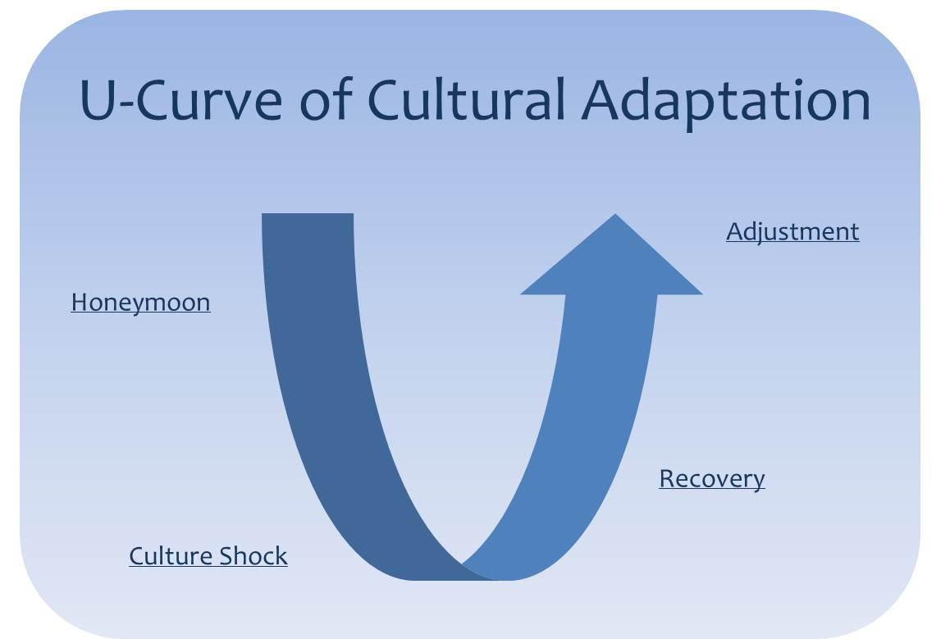

Slide 120
Stage 1: The Honeymoon Stage
Fascinated by the new culture
The first stage of cultural adaptation is called the honeymoon stage. You just arrived and there are so many attractive new things to learn, it´s feels like a holiday tour or honeymoon as some prefer to call it. The excitement of all the new things can give you a lot of energy and feelings; enough to beat or overlook possible problems and disappointment. The possibility to start all over in an unknown place can give a strong feeling of freedom. There are no expectations, no rules, no limitations; everything seems possible. This is the beginning of a dream come true.

Slide 121
Focused on practical arrangements
In addition to learning your new environment you are focused on creating the practical basis of your new existence. You will notice that even the most basic things, such as the installation of gas, water and electricity, can take up a lot of time. Simply because you don´t know yet where to go or maybe because you don´t master the local language yet. In short, not only fun things also practical arrangements have to be newly discovered.

Slide 122
Stage 2: The Culture Shock Stage
Disappointed with the new culture
The second stage tends to start three to four months after arrival. It is characterized by the feeling of culture shock, also described as the sensation of confusion associated with experiencing a new culture. This stage can be difficult as people begin to notice extreme differences between their native culture and the new one. How would you feel if you did not like the food of the new culture and could not have the food you normally like to eat?

Slide 123
When everything practical has set up and your new life takes form, you must seriously manage with living a new cultural context on a daily basis. You understand your new life with the taken-for-granted structures, traditions, values and social norms of your home culture. Conflicts and negative consequences of intercultural contact are (in many cases) inevitable upon comparing rules, meanings, and beliefs between the two cultures.

Slide 124
Living in a no-man´s-land
As you discover the cultural differences, you realize you have lost your home and it takes time to build up a new one. You are basically living in a no-man´s-land. The transitional phase of experiencing cultural issues and a sense of loss can cause a down period or depression. You may feel anything from confused to isolated to helpless to lonely to speechless to frustrated or even worse. You are officially culture shocked.

Slide 125
STAGE 3: Recovery
Learning to understand the new culture
Recovering from culture shock is vital for a successful emigrant experience, but it is also difficult as you cannot force it. Connecting to the place, people and culture has to grow. You are in the process of accepting that things are different from what you are used to. It is important that you develop a new set of assumptions that help to understand and predict the new situations and behaviors. Adapting yourself, your mind and your expectations is the secret; don’t think you will be able to change those around you. Recovering from culture shock means going through ups and downs, often struggling up to a year to reach the next stage.

Slide 126
Developing a new identity
As confusion and uncertainty regarding your role and identity in the new culture raise, you start looking for a balance between your old and new lives. Cross-cultural situations and the emptiness of living in a no-man´s-land invite you to look inside yourself in search for answers on personal questions. It is very common that emigrants struggle with the foundational questions of identity: Who am I? Who was I? Who will I be? What do I want from life? Where is my home? By expecting these questions you are filling up the emptiness and building a new sense of identity.

Slide 127
STAGE 4: Adjustment
Adjusting to the new culture
Congratulations! When you arrive at this point, you have made it through a tough period of life. Recovering from culture shock is a great achievement. You understand now that your chosen country is not paradise and that it has its own advantages and disadvantages seen from your point of view. With your freshly obtained cultural skills you can now appreciate your new home. You know that everything will be ok and you can work on living a satisfying and happy emigrant life.

Slide 128
The emigrant life has challenged you and you have experienced that cultural adaptation is not easy at all. It requires character, flexibility and honesty to the new culture and its customs to beat culture shock. Interaction with the new culture forced you to step back from yourself and become aware of your cultural observations. You may or may not adjust completely to the new culture one day; fact is that to some degree you have already become a mediator between two cultures.

Slide 129
Language & Culture
Language | Culture
Language is a system of communication which we used to express our ideas, feelings, emotions etc. | Culture taken in its widest ethnographic sense, which includes knowledge, belief, art, morals, custom, and any other capabilities and habits acquired by man as a member of society.

Slide 130
Culture is a word for people’s ‘way of life’, i.e., the way groups do things. Different groups of people may have different cultures. A culture is passed on to the next generation by learning, whereas genetics are passed on by heredity. Culture is seen in people's writing, religion, music, clothes, cooking, and in what they do.
The word 'culture' is most commonly used in three ways.
  Excellence of taste in the fine arts and humanities, also known as high culture.
  An integrated pattern of human knowledge, belief, and behavior.
  The outlook, attitudes, values, morals, goals, and customs shared by a society.

Slide 131
Culture encompasses religion, food, what we wear, how we wear it, our language, marriage, music, what we believe is right or wrong, how we sit at the table, how we greet visitors, how we behave with loved ones, and a million other things,“
The Inseparable Relationship
If we wish to master another language we need to become communicatively competent in that language. Linguistic accuracy is important for this communicative competence but is not sufficient. In acquiring the new language one needs to assimilate…a set of sociocultural rules that will guide the learner in the choice of appropriate forms.

Slide 132
The structures of language reflect COGNITIVE STRUCTURES.
CULTURE MIND LANGUAGE | Content Activities COGNITIVE STRUCTURES Assessment

Slide 133
Speakers
(cultural context)
Speakers
World View B
World View A
Language Meaning
(Symbolic Systems) (Semantics)
Language Meaning

Slide 134
Language
  System of human communication utilizing arbitrary vocal (or visual) symbols for the exchange of information.
Minimal linguistic event involves:
  two human beings with
  healthy auditory systems (receiver),
  healthy vocal systems (transmitter),
  healthy nervous systems connecting 2 and 3
  healthy brains;
  a physical link between the two humans
  a shared grammar

Slide 135
Why is language important?
  Communication
  cultural preservation
  Allows the communication of complex and abstract concepts.
  Provides a means by which customs, norms, and important information can be passed between generations and preserved.
  The process of language acquisition forms the way we think
  Language is the vehicle of culture.

Slide 136
SEMANTIC UNIVERSALITY
  Humans are able to convey information relevant to all aspects of experience and thought.
  The capability of human language which enables the speaker to think about and communicate not only concrete but also abstract ideas.
PRODUCTIVITY
  The capacity to create an infinite number of new messages with any level of detail. i.e. the capability of human language that enables the speaker to add an unpredictable meaning to any message.

Slide 137
DISPLACEMENT:
  The capability of human language that enables the speaker to express ideas out of immediate direct sensory contact.
ARBITRARINESS
  The feature of human language that speech is constructed out of sounds whose physical shape and meaning does not have any definite relations to human genetic programming or the object of reference.

Slide 138
Linguistics
  Linguistics is descriptive, and describes the way people talk not the way they should talk.
  Structural linguistics breaks down language into hierarchical levels of structure, from broader to smaller categories.

Slide 139
LANGUAGE ANALYSIS
All human languages are composed of, or can be described in terms of, the same basic elements.
Grammar:
  The rules that govern the structure of a language.
  A system located in human brains that specifies the relationship between sound and meaning in language.

Slide 140
Basic structure of grammars
  basic sounds
  rules for putting them together into minimal, basic sound-meaning pairs ("words")
  rules for putting minimal sound-meaning pairs into larger entities (phrases, sentences).

Slide 141
Types of Grammar
Descriptive grammar:
  an objective description model of the grammar of a natural spoken language (the product of linguistic analysis); description of how people actually speak.
Prescriptive grammar:
  statements regarding how people should speak (or write) in order to be considered "correct" or "educated" (social prescriptions, norms).

Slide 142
Phonetics
PHONETICS: The study of the phones or “individual” sounds that native speakers make.
PHONES: The basic, etic sounds that make up phonemes
PHONEMES: The basic sound units of the grammar, used to make different minimal sound-meaning pairs. The smallest sound contrasts that distinguish meaning.

Slide 143
Morphology
Morphology: The rules for combining phonemes into morphemes.
Morpheme: The smallest part of an utterance that has a definte meaning.
  minimal sound-meaning unit.
  Morphemes come in two varieties:
Bound Morpheme: a morpheme that never occurs alone (i.e., is not a word).
  Suffixes and prefixes: ing, ed, mal, pre,
Free Morpheme: a morpheme that may occur alone (i.e., is a word).

Slide 144
Root:
  the lexical/semantic "center" of a word; the invariant of a group of related stems.
Affixes:
  morphemes which are added to other morphemes (esp. roots, stems).
    A suffix follows the root/stem.
    A prefix precedes the root/stem.
    An infix is inserted into the root/stem

Slide 145
SYNTAX
The rules for combining morphemes (words) into sentences
Syntax consists of the unconscious rules which govern sentence structure and the ways in which words are ordered within sentences.
The basic and universal divisions of Syntax reflects fundamental aspects of how human speakers perceive the world: nouns for things, verbs for actions and events, adjectives for qualities.

Slide 146
SEMANTICS
semantics is used broadly to refer to study of meaning. It is also central to the study of communication.
branch of linguistics is mainly concerned with how the meaning conveyed by the linguistic system consisting of different units and structures like sentences, phrases, words and morphemes etc.
It is important for understanding language in social contexts, as these are likely to affect meaning.
It is also essential to the study of language change (how meanings alter over time).

Slide 147
Dialects
A way of speaking in a particular place
Speakers are sometimes considered less intelligent
Different ways of speaking depending on age, gender, occupation and class
Argument style is culturally learned
Mother-Infant talk
Bilingualism

Slide 148
Culture
is linked to communication and a wide range of human
experience including feelings, identity and sense-making
provides people with different ways of thinking, seeing, hearing and interpreting the world;
involves a number of man-made, collective artifacts and is shared by the members of a social group;
is something that shapes one‘s behaviour or structures one′s perception of the world.

Slide 149
The Five Communication Styles
Assertive
Aggressive
Passive-aggressive
Submissive
Manipulative
Different sorts of behaviour and language are characteristic of each.

Slide 150
The Assertive Style
Assertive communication (positive or self confident) is born of high self-esteem. It is the healthiest and most effective style of communication - the sweet spot between being too aggressive and too passive. When we are assertive, we have the confidence to communicate without resorting to games or manipulation. We know our limits and don't allow ourselves to be pushed beyond them just because someone else wants or needs something from us. Surprisingly, however, Assertive is the style most people use least.
Being assertive means respecting yourself and other people. It is the ability to clearly express your thoughts and feelings through open, honest and direct communication.

Slide 151
What is assertive communication?
Assertive communication is the ability to express positive and negative ideas and feelings in an open, honest and direct way.
It recognizes our rights at the same time as still respecting the rights of others.
It allows us to take responsibility for ourselves and our actions without judging or blaming other people.
And it allows us to constructively confront and find a mutually satisfying solution where conflict exists.

Slide 152
The advantages of assertiveness in communication.
There are many advantages of assertiveness in communication, most notably these:
Assertiveness helps us feel good about ourselves and others
Assertiveness leads to the development of mutual respect with others
Assertiveness increases our self-esteem
Assertiveness helps us achieve our goals
Assertiveness minimizes hurting and alienating other people
Assertiveness reduces anxiety
Assertiveness protects us from being taken advantage of by others
Assertiveness enables us to make decisions and free choices in life
Assertiveness enables us to express, both verbally and non-verbally, a wide range of feelings and thoughts, both positive and negative

Slide 153
Characteristics of assertiveness in communication
There are six main characteristics of assertiveness in communication. These are:
Eye contact: demonstrates interest, shows sincerity
Body posture: corresponding body language will improve the significance of the message
Gestures: appropriate gestures help to add importance
Voice: a level, well-modulated tone is more convincing and acceptable, and is not intimidating
Timing: use your judgement to maximize receptivity and impact
Content: how, where and when you choose to comment is probably more important than WHAT you say

Slide 154
AGGRESSIVE COMMUNICATION
AGGRESSIVE COMMUNICATION is a style in which individuals express their feelings and opinions and advocate for their needs in a way that violates the rights of others. Thus, aggressive communicators are verbally and/or physically abusive. Aggressive communication is born of low self-esteem (often caused by past physical and/or emotional abuse), unhealed emotional wounds, and feelings of powerlessness.
Aggressive communication, on the other hand, can prevent you from having solid friendships. Why? Because no one enjoys the company of someone who constantly judges, argues, disagrees, and doesn’t allow others to share their opinions.
You might be using aggressive communication if you ignore people, don’t take their feelings into consideration, talk more than you listen, or use aggressive gestures. This form of communication comes across as disrespectful and often wrecks relationships.

Slide 155
Aggressive communicators will often:
- try to dominate others
- use humiliation (dishonour) to control others
- criticize, blame, or attack others
- be very impulsive / irresponsible
- have low frustration tolerance
- speak in a loud, demanding, and overbearing/ arrogant voice
- act threateningly and rudely
- not listen well
- interrupt frequently
- use “you” statements
- have piercing eye contact and an overbearing posture

Slide 156
The aggressive communicator will say, believe, or behave like:
- “I’m superior and right and you’re inferior and wrong.”
- “I’m loud, bossy and pushy.”
- “I can dominate and intimidate / threaten you.”
- “I can violate your rights.”
- “I’ll get my way no matter what.”
- “You’re not worth anything.”
- “It’s all your fault.”
- “I react instantly.”
- “I’m entitled.”
- “You owe me.”
- “I own you.”

Slide 157
PASSIVE COMMUNICATION
PASSIVE COMMUNICATION is a style in which individuals have developed a pattern of avoiding expressing their opinions or feelings, protecting their rights, and identifying and meeting their needs. Passive communication is usually born of low self-esteem. These individuals believe: “I’m not worth taking care of.”
As a result, passive individuals do not respond overtly / openly to hurtful / wounding or anger-inducing situations. Instead, they allow grievances and annoyances / displeasures to support / mount, usually unaware of the build-up. But once they have reached their high tolerance threshold for unacceptable behaviour, they are prone / disposed to explosive outbursts, which are usually out of proportion / part to the triggering incident. After the outburst, however, they feel shame, guilt, and confusion, so they return to being passive.

Slide 158
Passive communicators will often:
- fail to assert / declare for themselves
- allow others to deliberately or inadvertently infringe/ occupy on their rights
- fail to express their feelings, needs, or opinions
- tend to speak softly or apologetically
- exhibit poor eye contact and slumped / fallen body posture
A passive communicator will say, believe, or behave like:
- “I’m unable to stand up for my rights.”
- “I don’t know what my rights are.”
- “I get stepped on by everyone."
- “I’m weak and unable to take care of myself.”
- “People never consider my feelings.”

Slide 159
PASSIVE-AGGRESSIVE COMMUNICATION
PASSIVE-AGGRESSIVE COMMUNICATION is a style in which individuals appear passive on the surface but are really acting out anger in a subtle, indirect, or behind-the-scenes way. Prisoners of War (POWs) often act in passive-aggressive ways to deal with an overwhelming / crushing lack of power. POWs may try to secretly sabotage / damage the prison, make fun of the enemy, or quietly disrupt the system while smiling and appearing cooperative.
People who develop a pattern of passive-aggressive communication usually feel powerless, stuck, and resentful / angry – in other words, they feel incapable of dealing directly with the object of their dislikes / resentments. Instead, they express their anger by subtly / indirect / decline or damage the object (real or imagined) of their dislikes / resentments. They smile at you while setting booby traps / tricks all around you.

Slide 160
Passive-Aggressive communicators will often:
- mutter / murmur to themselves rather than oppose or challenge the person or issue
- have difficulty acknowledging / recognising their anger
- use facial expressions that don't match how they feel - i.e., smiling when angry
- use sarcasm / irony
- deny / reject there is a problem
- appear cooperative while purposely doing things to annoy and disrupt
- use subtle sabotage to get even.

Slide 161
Behavioural Characteristics Indirectly aggressive / violent Sarcastic / mocking / disrespectful Devious / tricky Unreliable / unpredictable Complaining Sulky / angry Patronising / superior Gossips / talks Two-faced - Pleasant to people to their faces, but poisonous behind their backs (rumours, sabotage etc.) People do things to actively harm the other party e.g. they sabotage a machine by loosening a bolt or put too much salt in their food. | Non-Verbal Behaviour Voice – Often speaks with a sugary sweet voice. Posture – often asymmetrical – e.g. Standing with hand on hip, and hip thrust out (when being sarcastic or patronising) Gestures – Can be jerky irregular, quick Facial expression – Often looks sweet and innocent Spatial position – often too close, even touching other as pretends to be warm and friendly

Slide 162
The Submissive Style
This style is about pleasing / attractive other people and avoiding conflict / clash. A submissive person behaves as if other peoples' needs are more important, and other people have more rights and more to contribute.

Slide 163
Behavioural Characteristics Remorseful / Apologetic / sorry (feel as if you are commanding when you ask for what you want) Avoiding any confrontation / conflict Finding difficulty in taking responsibility or decisions Give up / yielding to someone else's preferences (and discounting own rights and needs) Selecting / Opting out Feeling like a victim / object / target Blaming others for events Refusing compliments Inexpressive (of feelings and desires) | Non-Verbal Behaviour Voice – Volume is soft Posture – make themselves as small as possible, head down Gestures – twist and fidget Facial expression – no eye contact Spatial position – make themselves smaller/lower than others Submissive behaviour is marked by a sacrifice / martyr -like attitude (victim mentality) and a refusal to try out initiatives, which might improve things.

Slide 164
The Manipulative Style
This style is cunning / scheming, calculating and smart / shrewd. Manipulative communicators are skilled at influencing or controlling others to their own advantage. Their spoken words hide an underlying message, of which the other person may be totally unaware.
Behavioural Characteristics
  Cunning
  Controlling of others in an insidious way – for example, by sulking
  Asking indirectly for needs to be met
  Making others feel grateful / obliged or sorry for them.
  Uses 'artificial' tears
Non-Verbal Behaviour
  Voice – superior / patronising, jealous / envious, slimy / ingratiating, often high pitch
  Facial expression – Can put on the 'hang dog" expression

Slide 165
cultural speaking rules
Cultural Differences in Styles of Expression and Communication. Communication styles vary across cultures, and communication norms are expressions of each culture's values. Cultures have informed rules that govern speaking, listening, and turn-taking behaviors.
Communication is culturally patterned. Speaking rules in different cultures have been studied more systematically since 1960s, particularly in ethnography of speaking (or ethnography of communication), founded by Dell Hymes

Slide 166
A typical example of this approach is the following characterization of Finnish speaking rules, proposed by Donal Carbaugh (1995):
Do not say the obvious!
When you speak say something worth of everybody´s attention!
Do not bring forth conflicting or questionable issues! Try to keep harmonious relationships!
Be personally committed in what you are saying!
What you say forms a basis for the subsequent interactions!
In the USA there are many cultures, each with their own speaking patterns and rules. In general it is important for the Americans to be able to express oneself by speaking. Everyone has the right to speak and to be heard. The social worth of the speech is less important than its personal significance. In these kinds of circumstances the amount of speech is large, and the topics of conversation are often personal experiences, thoughts and feelings. This may contribute to members of cultures representing other speaking patterns perceiving the Americans as being "superficial"

Slide 167
Conversation has been a particular focus of linguists and discourse analysts for several decades. In intercultural studies, many regularities of conversation and joint features have been found. Conversation is like a ball game: It has its own rules. The participants need to know how to open conversation, to respond appropriately, to maintain conversation and to finish it. Turn giving and taking has been found to be systematic and is signalled by, for example, nonverbal means (e.g., eye contact, body position) or paralinguistically (e.g., intonation). In intercultural encounters / meetings, different conversational rules can cause misunderstandings.
Pauses between turns, for instance, have been found to be longer in Finnish than in German conversation. This may lead to turn taking by Germans, which might be perceived by Finns as rude interruptions. Overlapping speech is common in Southern European conversation and is perceived as involvement and a sign of presence. In many Finnish contexts, overlapping speech is perceived as impolite.

Slide 168
CULTURALLY SPEAKING
In the United States, as elsewhere, there is a ritual / formal way to meet and greet people.
Certain rules or formulas should be followed.
The degree of formality in business varies according to the company culture.
Some companies are more conservative / traditional and formal in how they address each other, how they share information, how decisions are made, how power is delegated, how people dress, and so on.
Other companies, especially the younger, smaller high technology companies are very progressive / liberal or open - minded and informal.

Slide 169
If you are a foreigner doing business in America for the first time, you do not have to be more informal than you feel comfortable with.
if you want to call someone by his or her last name, you may do so.
But do not be surprised / interrupted or insulted!)
if your American hosts call you by your first name.
At some point, you will probably decide to do what they are doing.
The main thing is that you can go at your own speed.
In a truly formal situation, you can be more formal by using titles (Mr., Mrs. Ms., Dr., Professor, Mr., etc.) and by adding Sir or Ma’am yes, Sir/ No, Sir Yes, Ma'am/No Ma'am, Thank you, Sir Thank you, Ma'am, etc.).

Slide 170
Another thing to realize is that American business people today may know something about your country.
So they might try to address you in the style of your culture.
It could become very interesting, if not amusing / funny.
Along with the handshake, nod of the head, hug, or hand gesture, Americans engage in small talk.
This standard / systematic light conversation or chitchat may not carry much meaning in itself but, rather, is designed to break the ice - to ease into a conversation with someone you have just met.
Although the order of questions may vary, the same questions are always asked, and the same remarks made: How are you?
is answered by Fine, thanks or How are you?
This is not an inquiry into your physical health;
it is a standard greeting.
a fine, thank you is what is expected, even if your best friend was just diagnosed with a terminal illness.

Slide 171
You always engage in small talk when you first meet someone.
If you do not take part in this polite type of wordplay, you will be considered rude and unfriendly, therefore, it is essential to learn the formulas.
The goal of small talk is to get to know someone, yet you should never ask personal questions too soon;
instead, you start with questions or comments that elicit an expected response: this tells you if the person you are talking to is willing to communicate with you and, if so, on what level.
In the business world, there is small talk until a relationship established, after which one may talk specifically about business or personal concerns.

Slide 172
After business hours, when socializing with colleagues or associates, you will need to know the acceptable topics of conversation: weather, sports, good news, travel, positive comments about your host country, movies, entertainment, food, or the challenges of learning a foreign language. If asked, you may discuss work, where you live, or where you are staying.
After work hours, when people want to relax, discussions about work or anything too serious are usually not welcomed.
Subjects to avoid are: money, personal health, bad news, religion, politics, and details about your family or children (unless specifically asked)
Finally, be careful about jokes!
Humour varies from culture to culture, and you may offend / insult without realizing it.
There are few things more awkward than an unfunny joke, or one that is in bad taste.
People have very specific ideas about good and bad taste;

Slide 173
POLITENESS
Politeness is a form of social interaction that is conditioned by the socio-cultural norms of a particular society which can be expressed through communicative acts.
Brown and Levinson (1987) propose the Universal Politeness theory as an improvement of the ideas from the Grice’s and Leech’s Maxim and Fraser’s rules of Conversational Contract.
Brown and Levinson then refer to a Model Person (MP) who is seen as a fluent speaker of a natural language as the properties of rationality.

Slide 174
Brown and Levinson state “Model Person (MP) consists in is a wilful fluent speaker of a natural language, further endowed / brilliant with two special properties rationality and face” (1987:58). 2 Brown and Levinson (1987) discuss politeness primarily in relation to speech acts.
All sort of linguist communication are comprised of linguistic actions. Previously it was conceived that the very basic unit of communication is words, Symbols, sentences or some kind of token of all of these, but it was speech act theory which suggested that production or issuances if words, symbols are the basic units of communication. This issuance happens during the process of performance of speech act. The meaning of these basic units was considered as the building blocks of mutual understanding between the people intend to communicate.

Slide 175
The theory emphasis that the utterances have a different or specific meaning to its user and listener other than its meaning according to the language. The theory further identify that there are two kinds of utterances, they are called constative and performative utterances. In his book of ‘How do things with words’ Austin clearly talks about the disparities between the constative and performative utterances.
Performatives vs. Constatives
In its very beginning, speech acts were classified into performatives and constatives. Austin approves this classification as a branch of his speech act theory.

Slide 176
Constatives
These are certain utterances which do not denote an action and do not contain a performative verb that would direct the other party to perform an action.
As Austin says, these constatives are used only in descriptions and assertions. It is supposed that the proposed felicity conditions could not be applied to constatives. However, Austin realized that constatives might be performatives.

Slide 177
For example, somebody may say that "the window is open". The utterance here might be directive as the speaker wants the window to get closed. In that case, the constative utterance is classified as implicit performative for the performative verb is not clear.
Performative verb:
Convey information - I state that lost my file.
Request information - I ask who ate my sandwich?
Give orders - I order you to close the door!!!
Make requests - I request that you scratch my back.
Make threats - I threaten you that if you do it again, I will beat you.

Slide 178
From those examples, it is found that the distinction between constatives and performatives is not that clear. They might be overlapped. Thus, Austin shifts to another classification, as he differentiates between locutionary, illocutionary, and perlocutionary actions (Lyons 730).
Locution is any act of saying something meaningful.
The act in which a speaker specifies or has some purpose of his utterance e.g. his purpose is to threaten somebody, to warn someone, influence somebody, nominate somebody is called ILLOCUTION.
The final effect an act of speaking uses on a speaker is called PERLOCUTION.
A constative utterances is something which describes or denotes the situation, in relation with the fact of true or false.

Slide 179
Performatives
As Austin defines it, Performatives are those sentences that denote an action. When the speaker wants his listener or reader to perform an action, he just uses certain words in a certain context that direct the other party to perform that intended action (Huang 95). In that case, Austin uses the expression "felicity conditions". These are the set of rules under which an utterance would be governed as performative. These conditions are:

Slide 180
Those performatives should be based upon convention.
* The speaker should have the authority to perform that action.
* The intention should be understood by the hearer.
* "The procedure must be executed (i) correctly and (ii) completely."
*The utterance should reveal clearly its consequences.
He says also that if any of those conditions is not applied, then the performatives would be infelicitous (Huang 99).

Slide 181
Explicit performatives
Performatives could be further classified into explicit and implicit. Explicit performatives usually contain a performative verb which is apparent to the other party. It bears a clear cut meaning. In the utterance; "I promise to study," there is a clear performative verb which is "promise". The utterance in that case should be declarative. Its subject should be in the first person pronoun with an active, present simple verb. Yet, this rule has some exceptions as in "Passengers are requested to cross the railway line…." Here the subject of the utterance is plural, and the verb is in the passive mode, in spite of the fact that this is a performative utterance. In addition, these rules may be applied to constatives, as in "I promise to be there". Here, the speaker is just addressing himself (Lyons 728&729).

Slide 182
ii. Constatives
These are certain utterances which do not denote an action. The do not contain a performative verb that would direct the other party to perform an action. As Austin says, these constatives are used only in descriptions and assertions (HUANG 95). It is supposed that the proposed felicity conditions could not be applied to constatives. However, Austin realized that constatives might be performatives. For example, somebody may say that "the window is open". The utterance here might be directive as the interlocutor wants the window to get closed. In that case, the constative utterance is classified as implicit performative for the performative verb is not clear. From those examples, it is found that the distinction between constatives and performatives is not that clear. They might be overlapped. Thus, Austin shifts to another classification, as he differentiates between locutionary, illocutionary, and perlocutionary actions (Lyons 730).

Slide 183
The performative utterances is something which do not describes anything at all. The utterances in the sentences or in the part of sentences are normally considered as having a meaning of its own. The feelings, attitudes, emotions and thoughts of the person performing linguistic act are much of a principal unit here.
Example: Bane and Sarah have been dating for the past four years. One fine evening Bane took Sarah to the most expensive restaurant in town. And he ordered the most expensive wine available in the restaurant. Then he moved closer to her and asked her that “ will you marry me?”. Sarah burst with pleasure and replied “I will”. Here the “I will” of Sarah express her feelings, attitudes and emotional towards the context. This utterances have its specific meaning only in relation to it specific context.

Slide 184
They also explain that face consists of two related wants: positive and negative face. Positive face is a person’s want to be appreciated and approved of by selected others, in terms of personality, desires, behavior, values, and so on. In another side, negative face is a person’s want to be unimpeded by others, the desire to be free to act as she or he chooses and not to be imposed upon.
To reduce acts which threaten face, Brown and Levinson propose strategies, known as face threatening acts (FTAs).

Slide 185
A face-threatening act (FTA) is an act which challenges the face wants of an interlocutor. According to Brown and Levinson (1987 [1978]), face-threatening acts may threaten either the speaker's face or the hearer's face, and they may threaten either positive face or negative face.
Types of FTAs
FTAs Threatening the Hearer’s Face
Positive Face
FTAs threatening the hearer’s self-image include (i) expressions negatively evaluating the hearer’s positive face, e.g. disapproval, criticism, complaints, accusations, contradictions, disagreements etc., as well as (ii) expressions which show that the speaker does not care about H’s positive face, e.g. expressions of violent emotions, taboo topics, bad news, emotional topics, interruptions etc.

Slide 186
Examples
Criticism: “I think your report was not concise enough.” -> The hearer’s positive face is threatened because s/he is blamed for having done sth. badly, i.e. his/her self-image is negatively evaluated.
Expression of emotions: "You’re feeling sad because of your ex-boyfriend, aren’t you?” -> The speaker addresses a topic which involves a state of emotional weakness on the part of the hearer, i.e. the speaker does not care about the 'public self-image' of the hearer, thus threatening his/her face.

Slide 187
Negative Face
FTAs restricting the hearer’s personal freedom include (i) acts predicating a future act of the hearer, e.g. orders/requests, suggestions/advice, reminding, threats/warnings/dares, (ii) acts predicating a future act of the speaker towards the hearer, e.g. offers/promises, and (iii) acts expressing a desire of the speaker towards the hearer or his/her goods, e.g. compliments, expressions of emotions.
Examples:
Order: “Please give me that book.” -> The speaker expresses an anticipation of some future action of the hearer and thereby restricts his/her personal freedom.
Promise: “I promise I will come by tomorrow.” -> The speaker states a future action in which the hearer should be involved.
Compliment: “I really like you.” -> The speaker expresses positive emotions towards the hearer which may involve an anticipation of a positive reaction by the hearer (giving thanks/expressing positive emotions towards the speaker).

Slide 188
FTAs Threatening the Speaker’s Face
Positive Face
FTAs threatening the speaker’s self-image include apologies, acceptance of a compliment, breakdown of physical/emotional control, self-humiliation, confession etc.
Example:
Apology: “I think I made a huge mistake.” -> The speaker makes a statement about his/her own shortcomings, thereby 'damaging' his/her own positive self-image/face.
Negative Face
FTAs threatening the speaker’s personal freedom include theexpresion of thanks, acceptance of thanks/offers/compliments, apologies, excuses etc.
Example:
Expression of thanks: “Thank you so much for your help.” -> The speaker expresses thanks because he/she feels obliged to do so. His freedom of action is thus threatened in the moment of speaking.

Slide 189
Six techniques for assertiveness in communication
1. Behaviour Rehearsal:
Behaviour Rehearsal which is literally practicing how you want to look and sound. It is a very useful technique when you first want to use "I" statements, as it helps disperse any emotion associated with an experience and allows you to accurately identify the behaviour you wish to meet.
Behavioral rehearsal is a therapy technique in which behaviors, responses, and social skills are practiced and imagined being in use in order to prepare for when they will be used in reality. Think about a rehearsal for a play - the actors go through their lines and stage actions as if they were performing before the crowd on opening night. Behavioral rehearsal is a similar concept - a person can rehearse and practice behaviors and responses in order to be ready to use them in real life. Behavioral rehearsal is a way to improve social skills and interactions with other people.
There are different ways to do this. A person could simply imagine themselves in a social setting and picture themselves performing behaviors and responding appropriately. Other methods include role playing or talking about future behaviors and responses with another person.

Slide 190
2. Repeated Assertion
This assertiveness technique allows you to feel comfortable by ignoring controlling verbal side behaviors, challenging or awkward attracting and irrelevant logic while sticking to your point. To most effectively use this assertiveness technique use calm repetition, and say what you want and stay focused on the issue. You'll find that there is no need to rehearse this technique, and no need to 'hype (promote) yourself up' to deal with others.
Example:
"I would like to show you some of our products"
"No thank you, I'm not interested"
"I really have a great range to offer you"
"That may be true, but I'm not interested at the moment"
"Is there someone else here who would be interested?"
"I don't want any of these products"
"Ok, would you take this brochure and think about it?"
"Yes, I will take a brochure"
"Thank you"
"You're welcome"

Slide 191
3. Fogging
This technique allows you to receive criticism comfortably, without getting anxious or defensive, and without rewarding manipulative criticism. To do this you need to acknowledge the criticism, agree that there may be some truth to what they say, but remain the judge of your choice of action. An example of this could be, "I agree that there are probably times when I don't give you answers to your questions.

Slide 192
4. Negative enquiry
This assertiveness technique seeks /try to find out criticism about yourself in close relationships by encouraging the expression of honest, negative feelings to improve communication. To use it effectively you need to listen for critical comments, clarify your understanding of those criticisms, use the information if it will be helpful or ignore the information if it is manipulative. An example of this assertiveness technique would be, "so you think/believe that I am not interested?"

Slide 193
5. Negative assertion
This assertiveness technique lets you look more comfortably at negatives in your own behaviour or personality without feeling defensive or anxious, this also reduces your critics' unfriendliness. You should accept your errors or faults, but not apologies. Instead, tentatively and sympathetically agree with unfriendly criticism of your negative qualities. An example would be, "yes, you're right. I don't always listen closely to what you have to say."

Slide 194
6. Workable compromise
When you feel that your self-respect is not in question, consider a workable compromise with the other person. You can always bargain for your material goals unless the compromise affects your personal feelings of self-respect. However, if the end goal involves a matter of your self-worth and self-respect, THERE CAN BE NO COMPROMISE. An example of this assertiveness technique would be, "I understand that you have a need to talk and I need to finish what i'm doing. So what about meeting in half an hour?"

Slide 195
Conclusion
Assertiveness is a useful communication tool. It's application is contextual and it's not appropriate to be assertive in all situations. Remember, your sudden use of assertiveness may be perceived as an act of aggression by others.
There's also no guarantee of success, even when you use assertive communication styles appropriately.
"Nothing on earth can stop the individual with the right mental attitude from achieving their goal; nothing on earth can help the individual with the wrong mental attitude" w.W. Ziege
When you match consumer psychology with effective communication styles you get a powerful combination. Lee hopkins can show you how to communicate better for better business results.

Slide 196
Thank you

